Slide 1
parsec
The space odyssey
A web app that helps you search details of exoplanets in an effective and interactive manner and a user login portal with features like online quiz .
As I say ‘ it is not facebook it is Github for space walkers ’.
MADE BY : NILESH TANWAR
CODING NAME : parsec

Slide 2
Introduction
Decide whether you want to Witness the change or Be the change. Let's travel beyond our solar system and explore other exoplanets beyond the dreams thousands of light year ahead from now where we also don’t know life actually exists or if we find a completely different environment. This project provides you the data of 3584 exoplantets in form of a webapp that can be utilised to access the information of these exoplanets using a smart search.
This web app has a huge database of discovered exoplanets ( like when were they discovered and how far are they from us). The people who are interested in space theories and to all those Kepler's fan the site might be a huge data source to support their hobby as - 'we are not the only one here'.
From the developer - Parsec , any future development in this web app may be like we can have a separate login for each user and create it a common place for aspirants and experts to exchange the theories. Parsec has provided a signup/login system which can be utilised for the same. Any amendments are subjected to the response Parsec get on this website as we can transform this idea to a completely revolutionary web app where day to day updates from experts can reach the aspirants in no time.

Slide 3
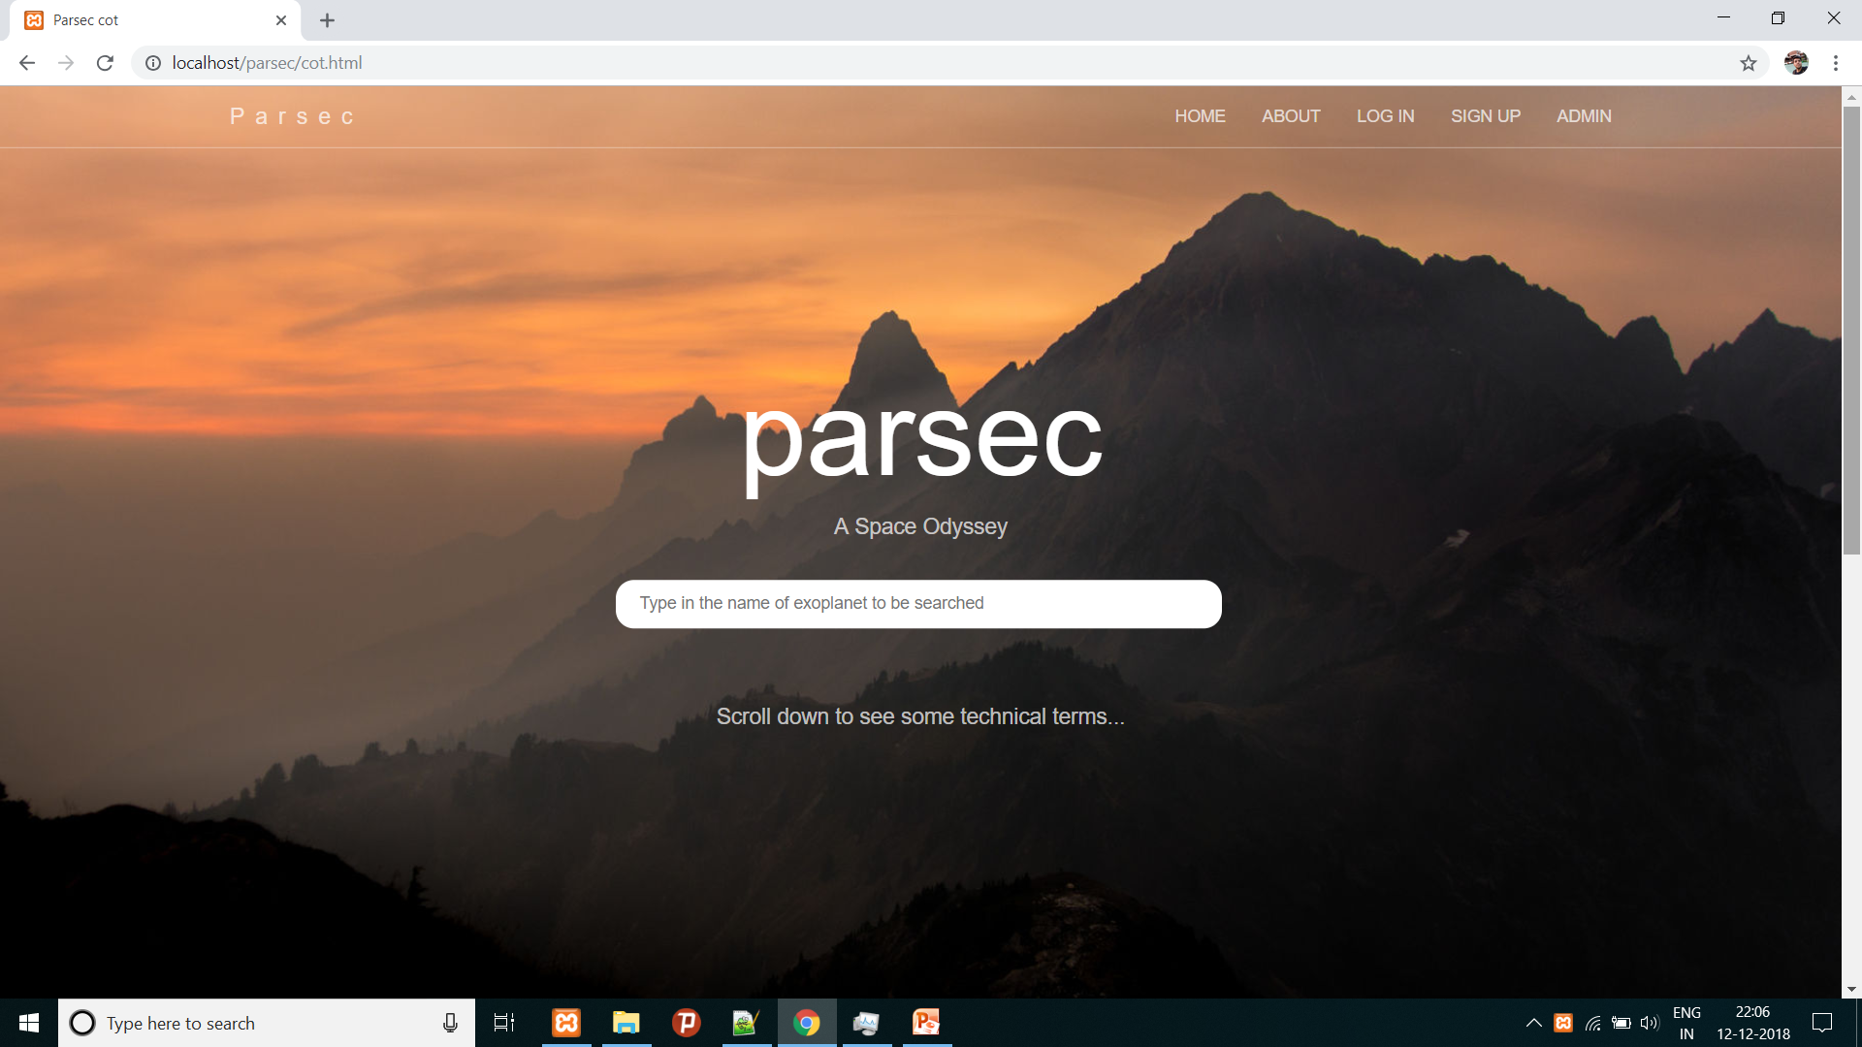
The search page
This is the first page you first visit my web app.
This search is accomplished via AJAX and backend connectivity is provided with database where the query gets executed and displays results that matches the entered string in real time.
“select * from table where planet-name like ‘<entered string%>’ ”
This is the search box wherein you can type and search for 3584 exoplanets.
Scroll down to see technical details.

Slide 4
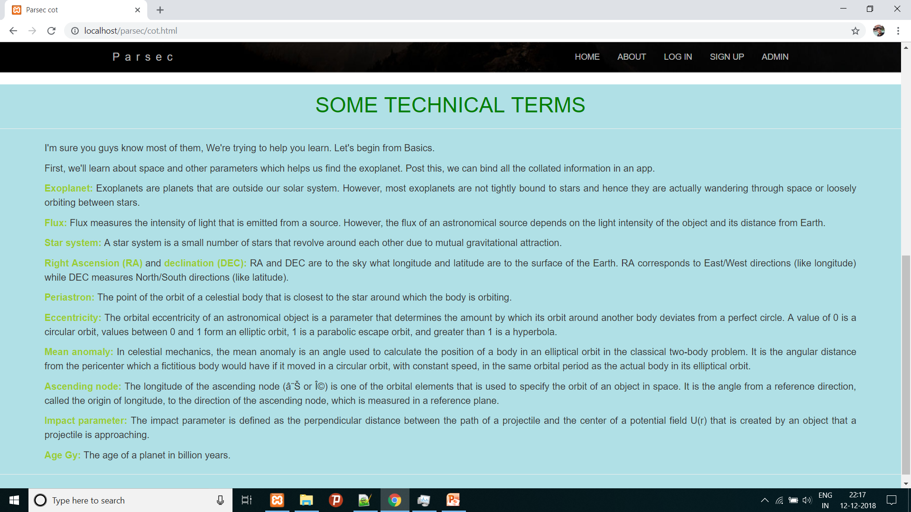
Technical terms
These are some technical terms listed below the search page and also about page to help new people understand the terms used

Slide 5
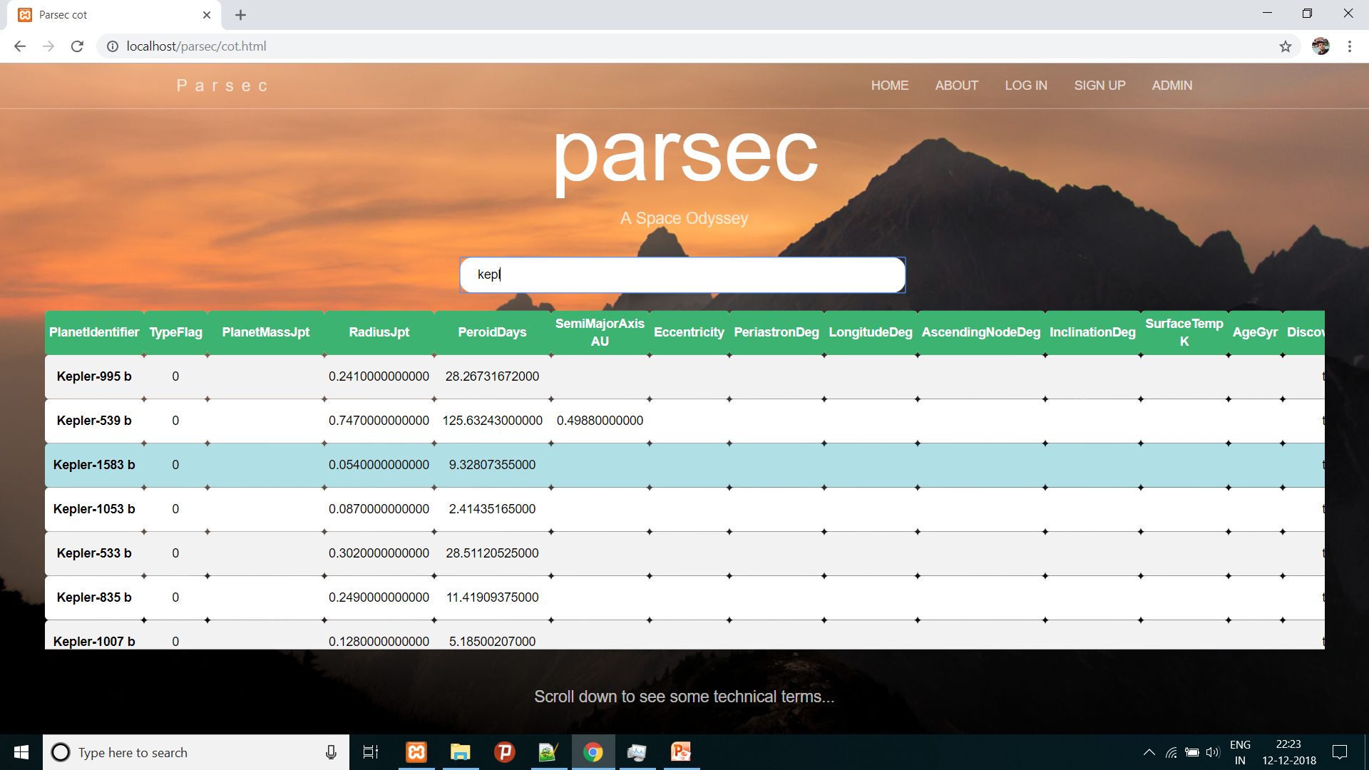
Search box : AJAX
This is AJAX enabled search like the one you have in Google (not that advanced). See you get the list all the exoplanets starting with ‘kepl’ as soon as you type in the name of planet and you can scroll down and right to explore more about them.
Scroll right to see more details
Scroll down to see more exoplanets.

Slide 6
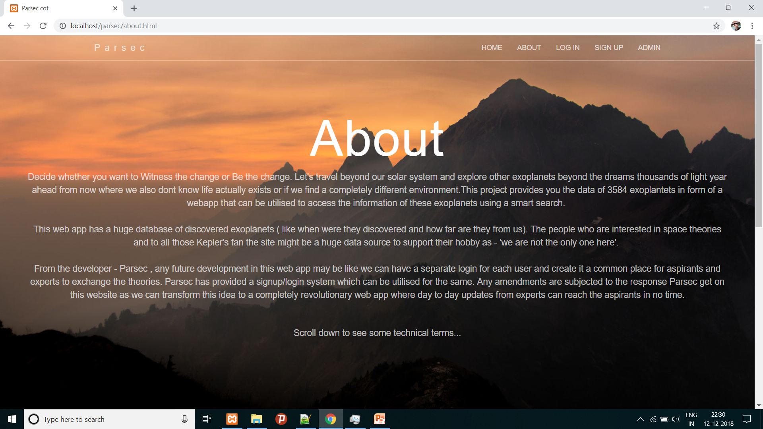
About page
Tells a little bit about my web app rest all has to be explored

Slide 7
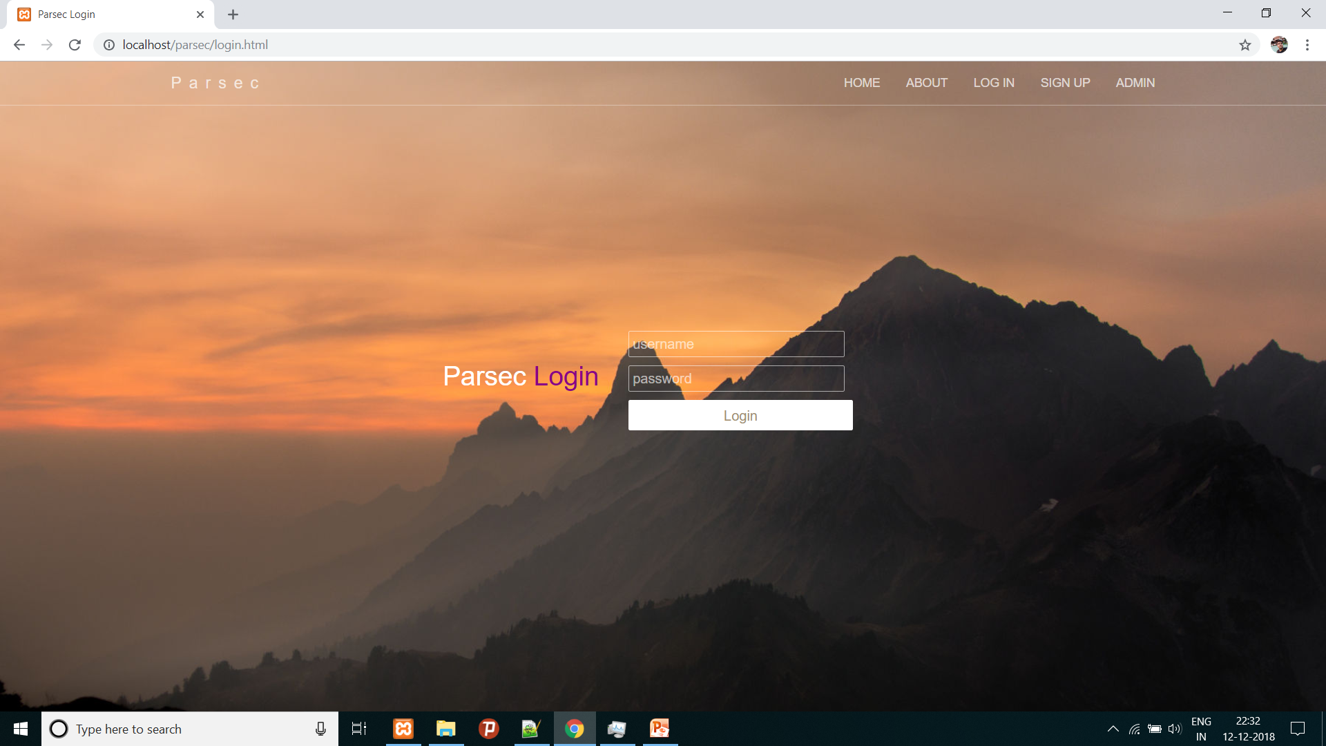
Login page
This page let a user to signin to the user portal once the user is registered.

Slide 8
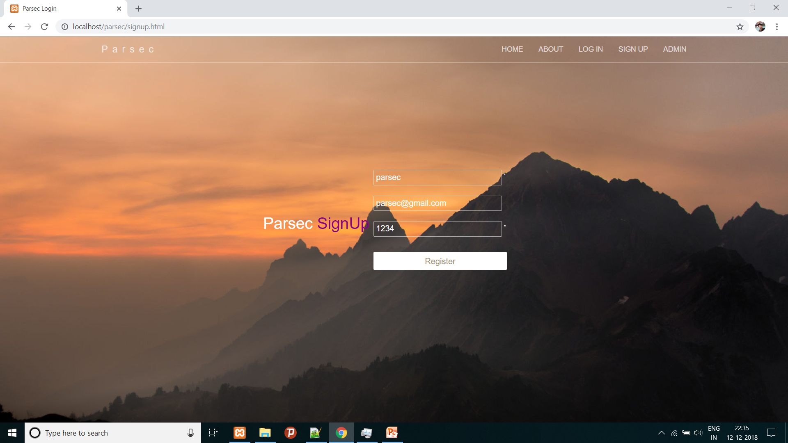
Signup page
This page let a user to signup to get his own userid.

Slide 9
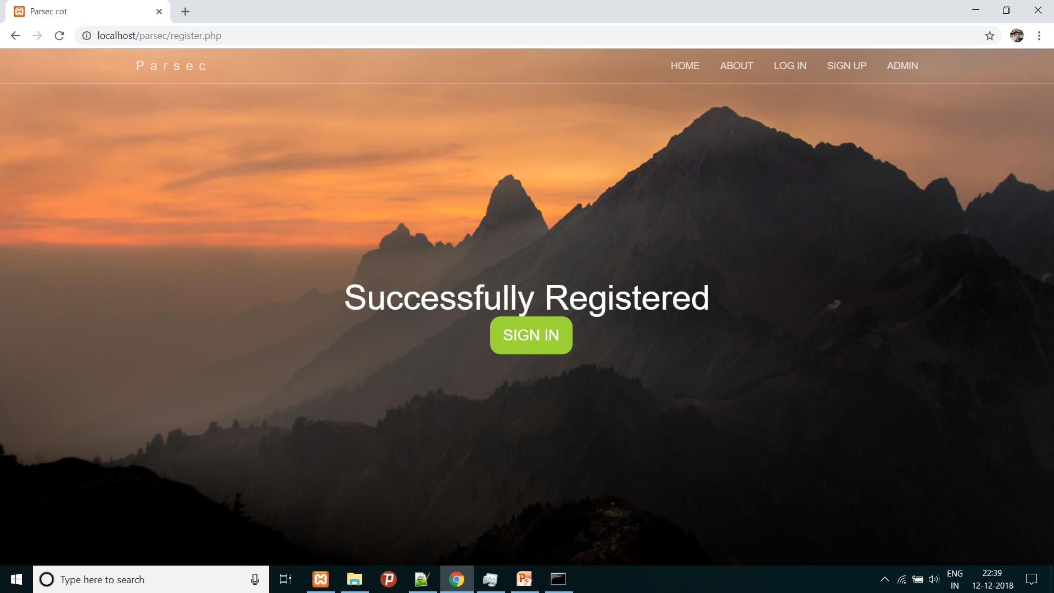
Confirmation page
This page is a confirmation that user-id is unique and you can now login.

Slide 10

Admin login page
This page is for admin to provide sign in and for now it is open for all as for now admin can take a view at all profiles registered by knowing the name only and what’s next page to reflect the future ideas of development the coder has.

Slide 11

Anonymous users ALERT
This page for anonymous users who try to access the data beyond their reach and will appear to user if they try to come back even if they have logged out as I have stated earlier the safe login with session variables. These variables are checked at each and every page within user portal.

Slide 12
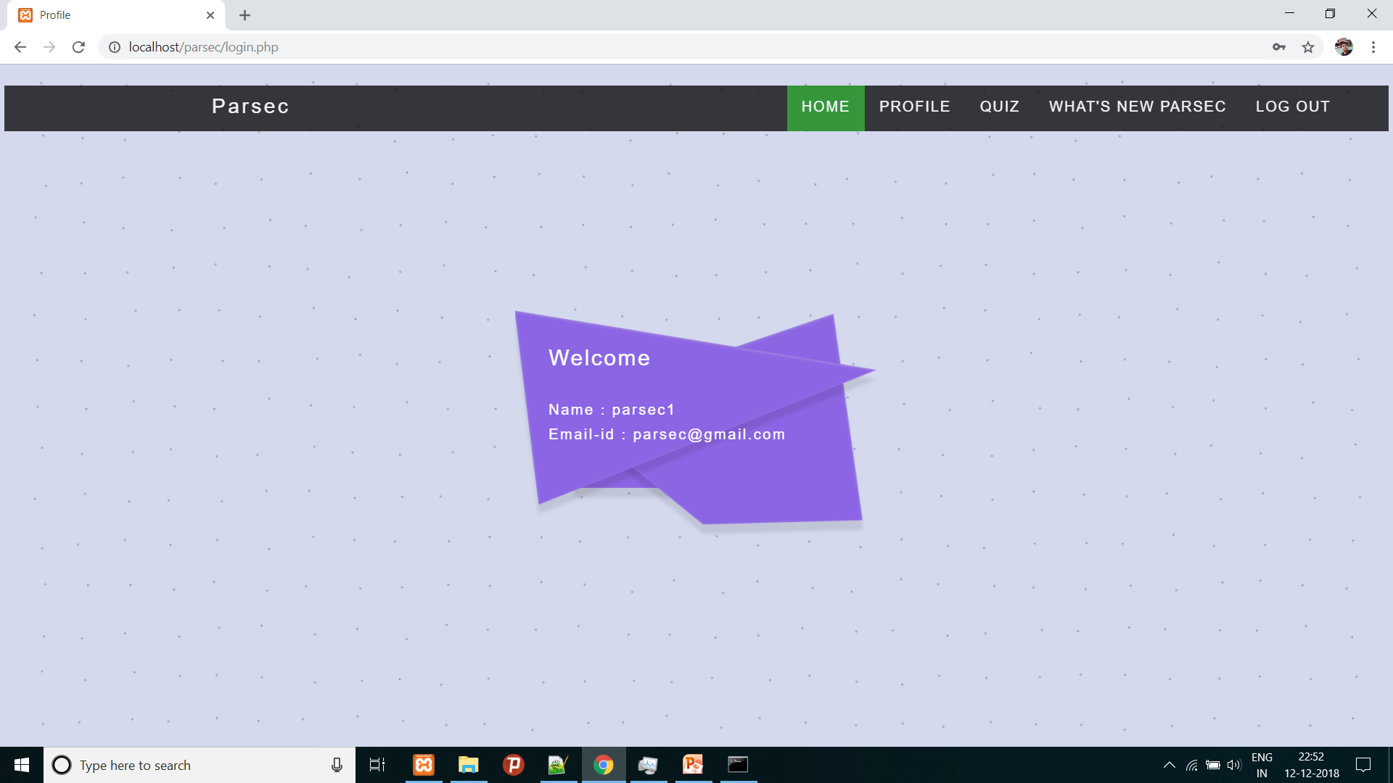
User portal
This is the user first page when he/she login and it has got a moving <svg> and a dynamic background with moving dots and displays the name and email id of the person who logged in.
navbar made via bootstrap

Slide 13
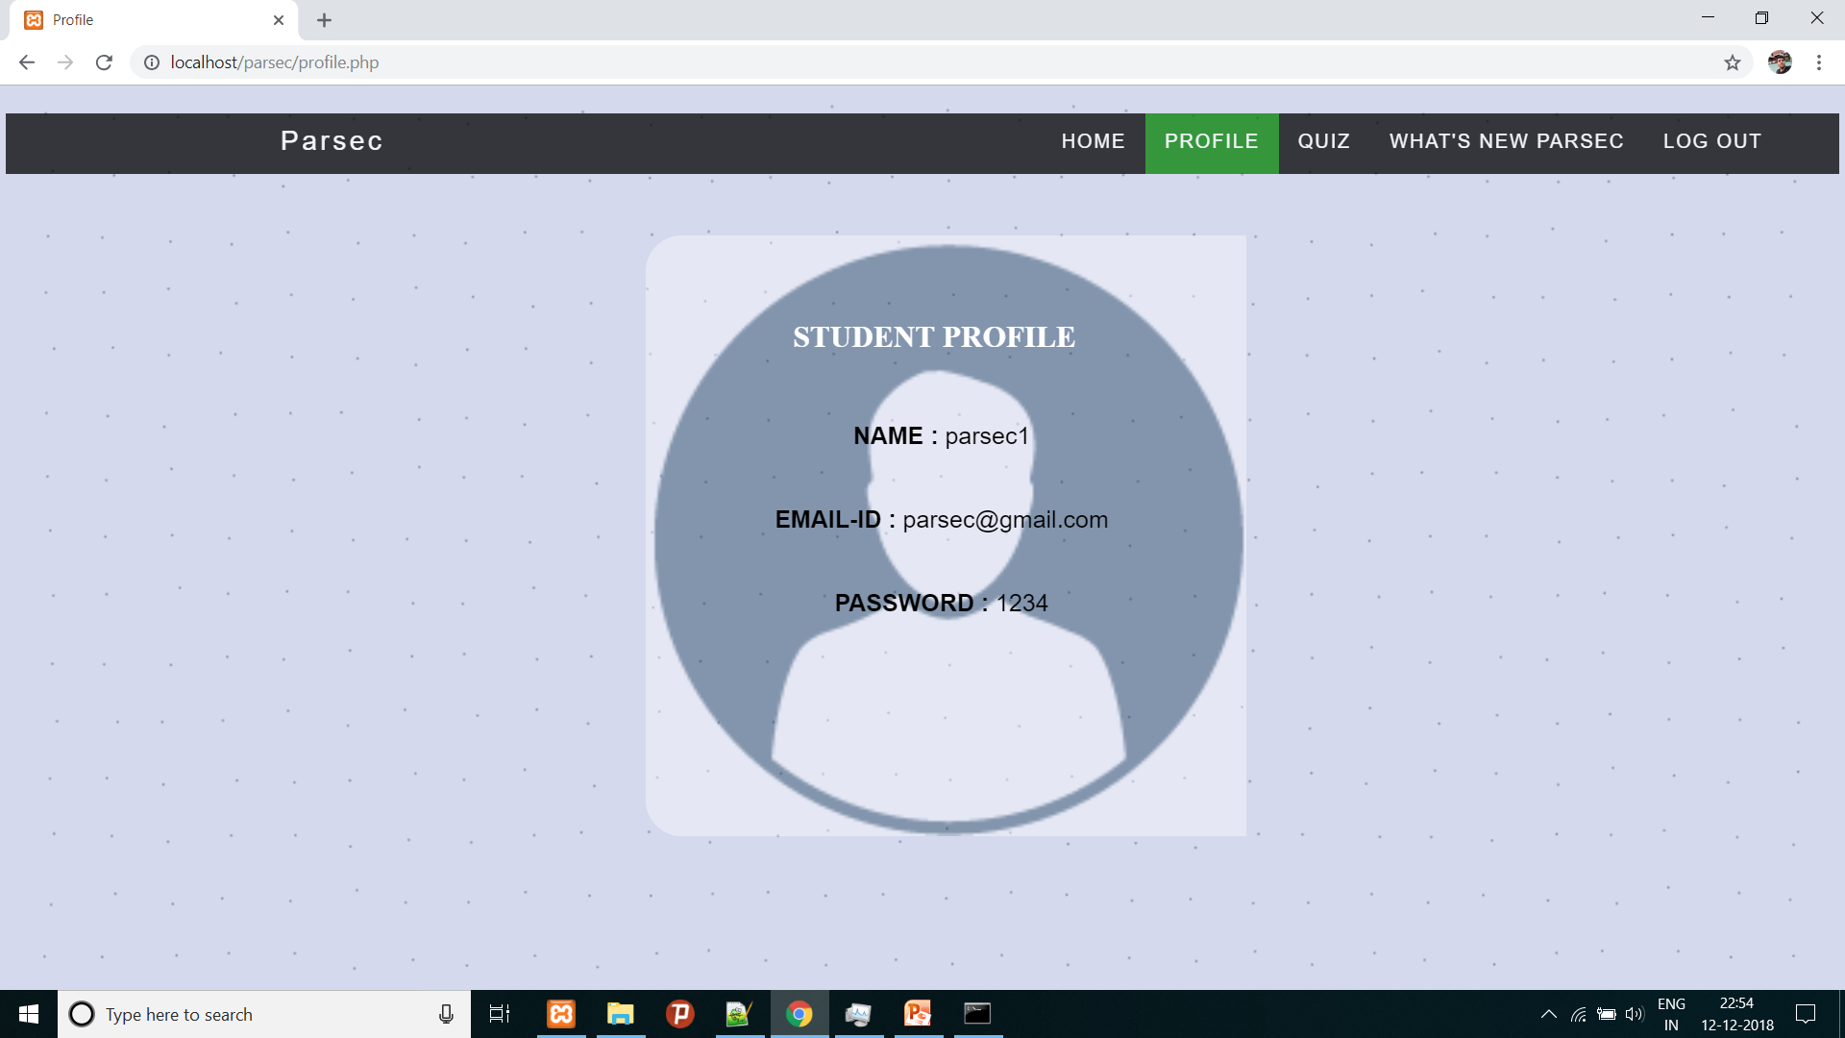
Profile page
This page gives user the information about the user.

Slide 14
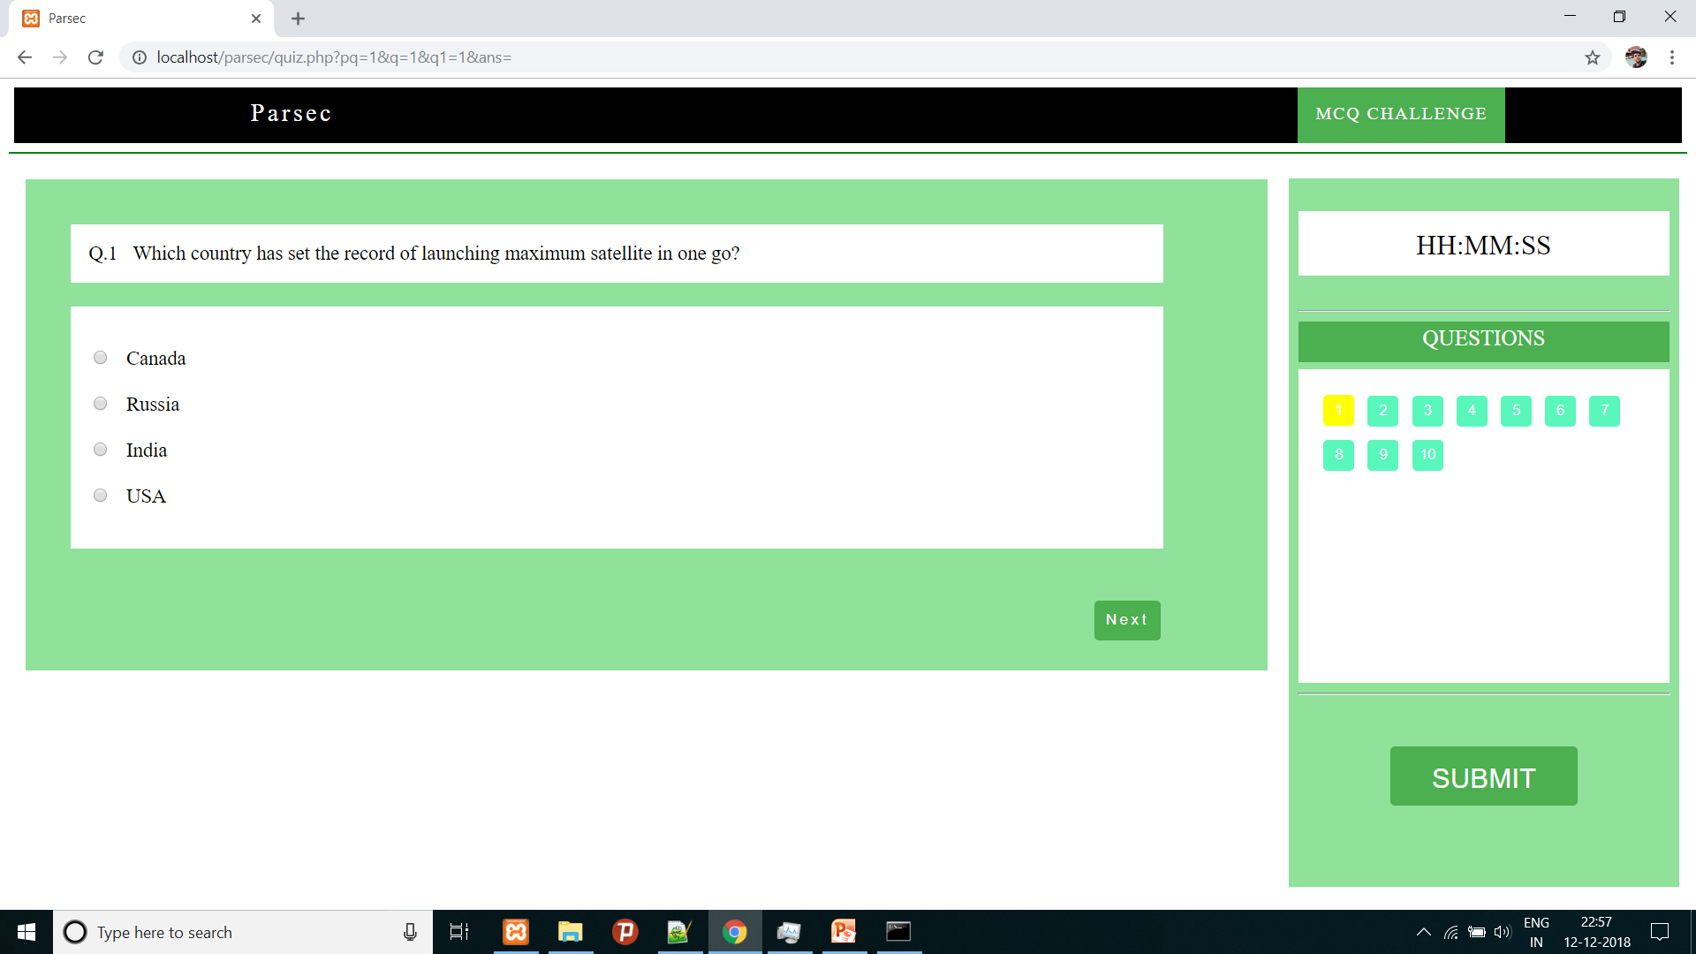
Online Quiz
This is an interactive quiz page that has got questions and data for question is coming from database the answers are also recorded ,the coder (me) has not created a limit on number of times you can play quiz and there is no evaluation for now because for now it is just for fun and learning purpose . The number of questions can be further extended as and when required.
Other links will be deactivated while quiz is running the user can submit and leave the quiz. The colour of buttons on right side changes as you attempt any question.

Slide 15
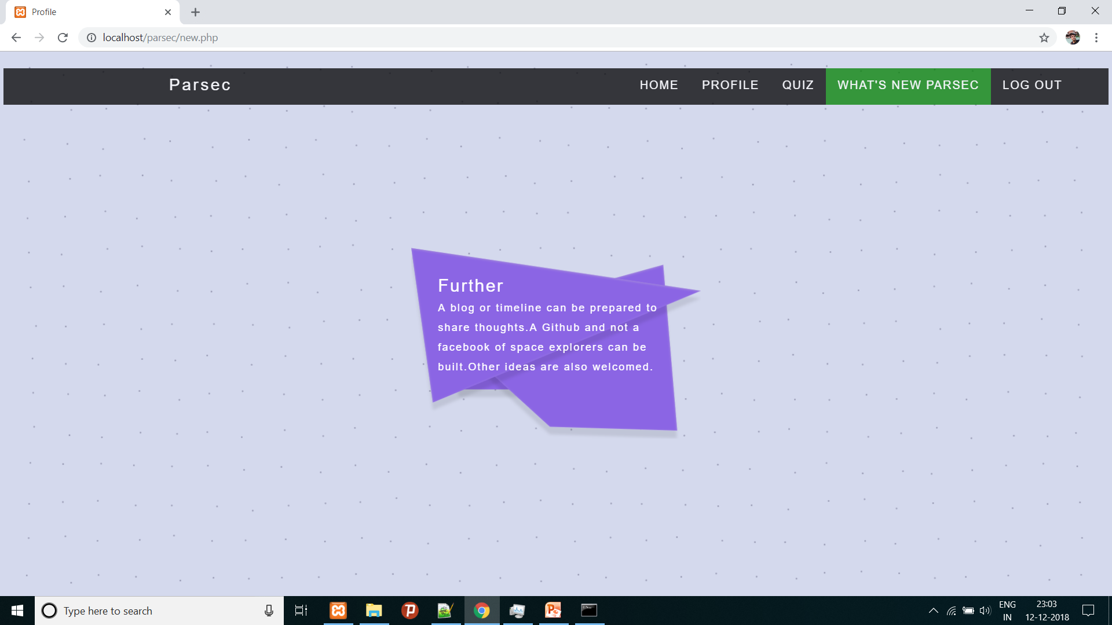
What’s next ?
This is the page which ‘Elon Musk’ will every time make if he works on a project. This page tells the user what could be the future possibilities with this web app.
But I am not ‘Elon Musk’ I can just adjust with it.

Slide 16

Logout : Safe Login
The login is secured by creating a session variable when someone login and when the user logout’s then the session is unset and destroyed and for layman the login is secure (hackers don’t take this on your ego).

Slide 17
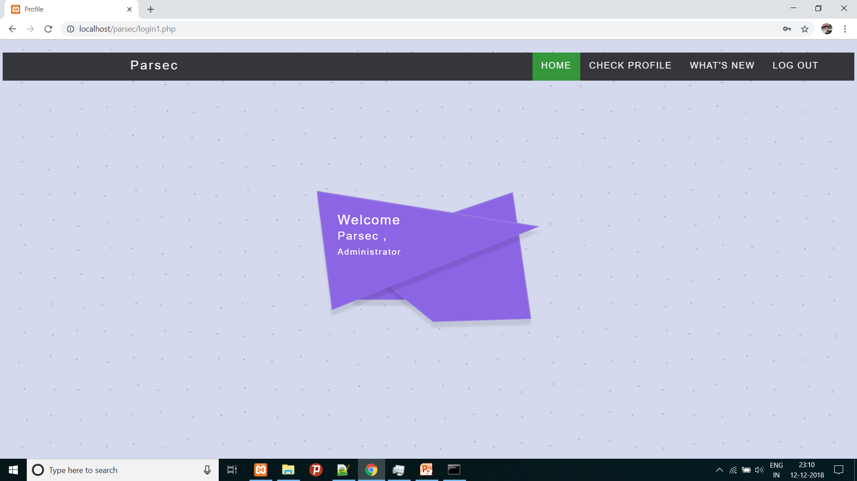
Admin portal
This is the admin first page when he/she login and it has got a moving <svg> and a dynamic background with moving dots.

Slide 18
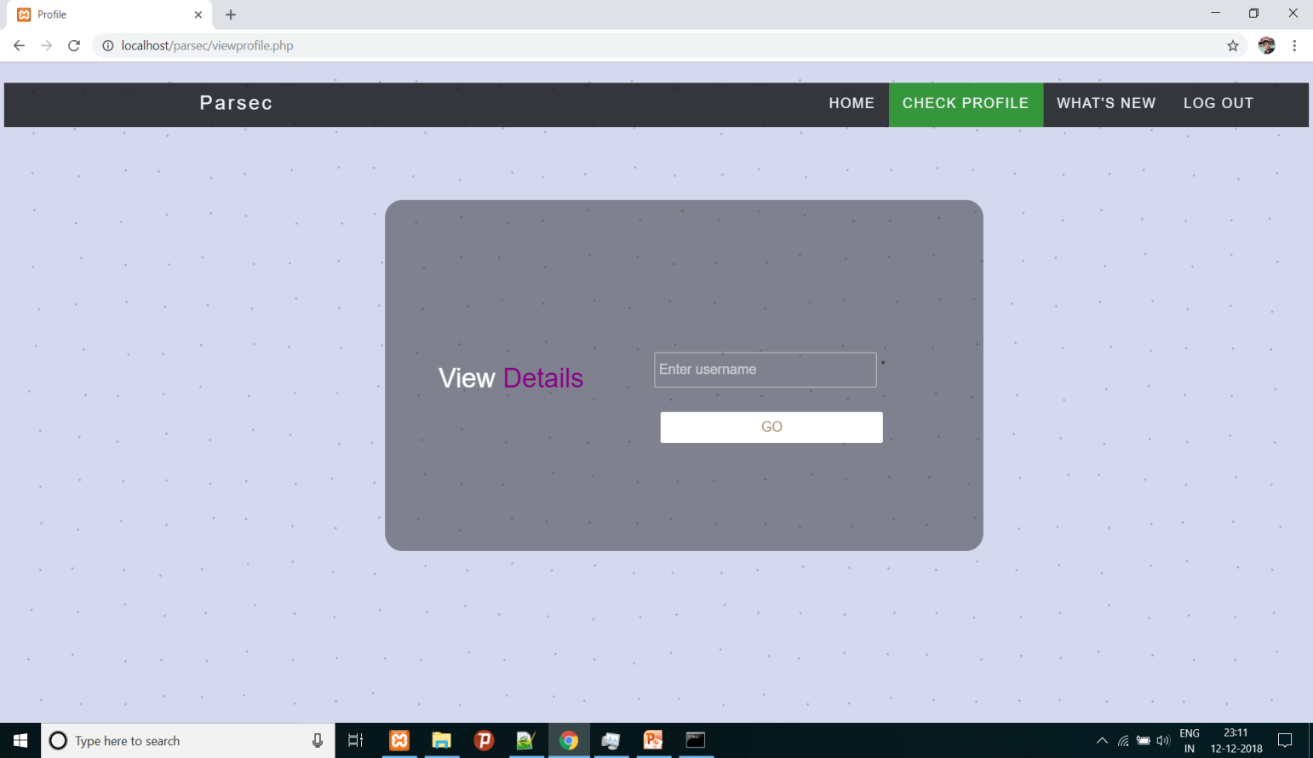

Search user
This page is for admin to search the users who have been registered by their name and for now it is open for all but not a big problem because one can’t search you unless he/she has your name.(hackers ….)
That’s how it look like

Slide 19
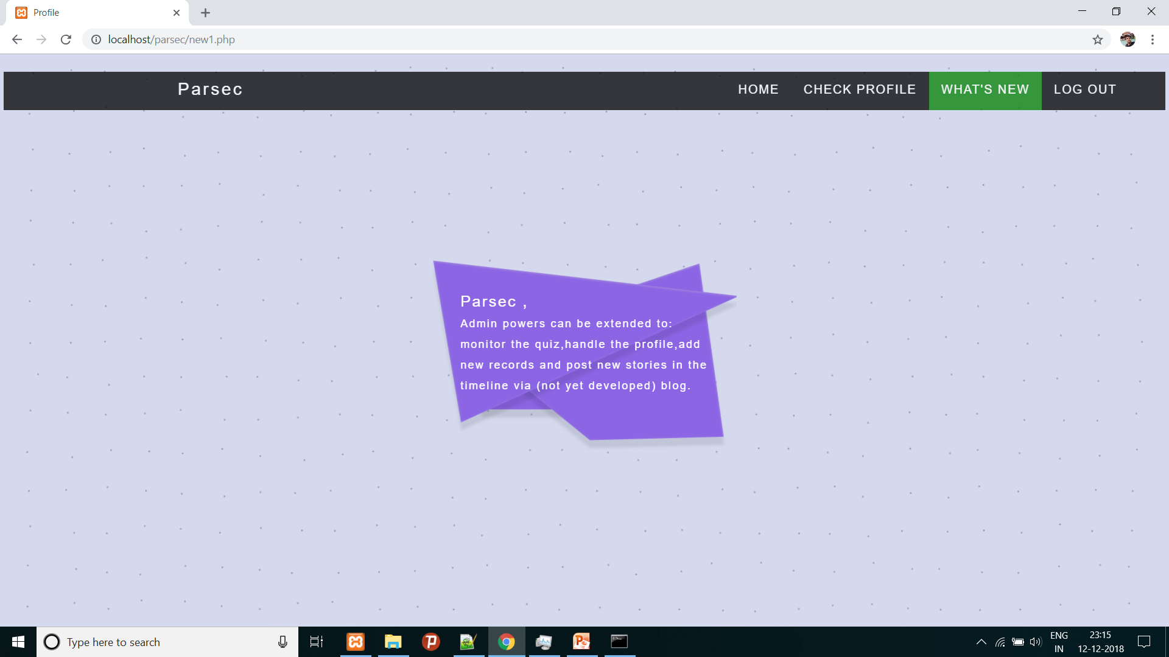
What’s next ?
The Elon Musk thing……
you know. From admin point of view.

Slide 20


And that’s all
Bibliography : All the content is learnt from internet and various other sources by the coder.
Salient features: JavaScript that makes the user portal ‘work so beautiful’ , CSS that makes it soothing to eyes , the online quiz idea , AJAX enabled search and lot’s more.’
An open window to edit and learn.
The name “parsec” is used by me to code at different website sand I have a blog named parsec for writing my poem.
Parsec : the space odyssey is a
For space walkers

